Slide 1
Window-based Stream Data Analytics with SPARK and Kafka
5. Apache Spark Streaming

Slide 2
Learning Outlines
What is Streaming?
What is Spark Streaming?
Why Spark Streaming?
Spark Streaming Features
Discretized Stream
Spark Streaming Example

Slide 3
Learning Outlines
What is Streaming?
What is Spark Streaming?
Why Spark Streaming?
Spark Streaming Features
Discretized Stream
Spark Streaming Example

Slide 4
What is Streaming?
A data stream is an unbounded sequence of data arriving continuously.
Streaming divides continuously flowing input data into discrete units for processing.
Data Streaming is a technique for transferring data so that it can be processed as a steady and continuous stream.
Streaming technologies are becoming increasingly important with the growth of the Internet.

Slide 5
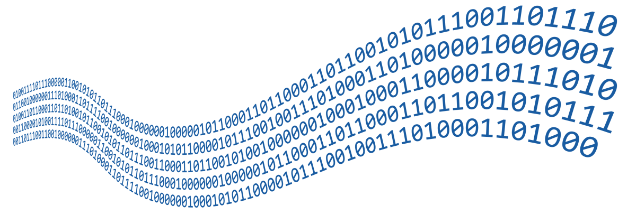






Streaming Examples
Examples:
Fraud detection in bank transactions
Anomalies detection in sensor data
Malware recognition in network data
Personalizing advertisement
Fault detection of wind turbines in wind farms
Stock market prediction
...

Slide 6
Learning Outlines
What is Streaming?
What is Spark Streaming?
Why Spark Streaming?
Spark Streaming Features
Discretized Stream
Spark Streaming Example

Slide 7
What is Spark Streaming?
Spark Streaming was added to Apache Spark in 2013, an extension of the core Spark API that provides scalable, high-throughput and fault-tolerant stream processing of live data streams.
Spark Streaming supports data sources such as HDFS directories, TCP sockets, Kafka, Flume, Twitter, Kinesis, etc and can be processed using complex algorithms expressed with high-level functions like map, reduce, join and window.
Processed data can be pushed out to filesystems, databases, and live dashboards.

Slide 8
What is Spark Streaming?
Kafka
Flume
HDFS
HDFS
Spark Streaming
Spark Engine
Databases
Kinesis
Dashboard
Twitter
Input Data
Stream
Batches of input Data
Batches of Processed Data
Micro-Batch

Slide 9
Micro-Batch
Micro batching is a core Spark technique that lets a task or process handle a stream as a sequence containing data chunks or small batches.
In case of incoming streams, events can be packed into various small batches and then delivered for processing to a batch system.

Slide 10
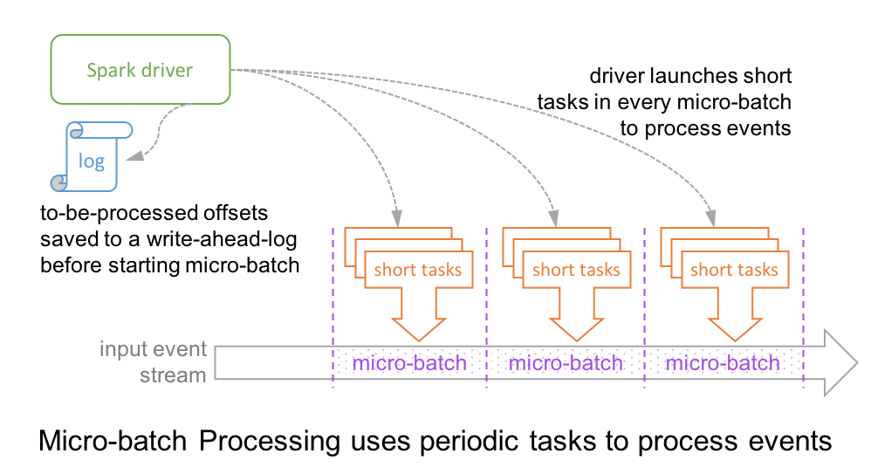
Micro-Batch Processing
In this architecture, the driver checkpoints the progress by saving the records offsets to a write-ahead-log, which may be then used to restart the query.
Note that the range offsets to be processed in the next micro-batch is saved to the log before the micro-batch has started in order to get deterministic re-executions.
As a result, a record that is available at the source may have to wait for the current micro-batch to be completed before its offset is logged and the next micro-batch processes it.
Notes:
Source: https://databricks.com/blog/2018/03/20/low-latency-continuous-processing-mode-in-structured-streaming-in-apache-spark-2-3-0.html

Slide 11
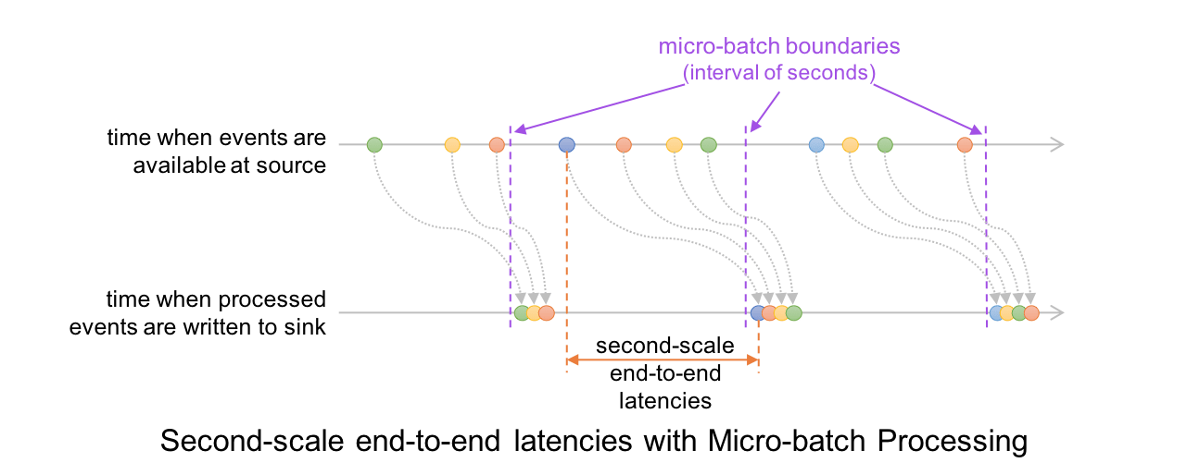
Micro-Batch Processing
At the record level, the timeline looks like this:
This results in latencies of 100s of milliseconds at best, between the time an event is available at the source and when the output is written to the sink.
Notes:
Source: https://databricks.com/blog/2018/03/20/low-latency-continuous-processing-mode-in-structured-streaming-in-apache-spark-2-3-0.html

Slide 12
Learning Outlines
What is Streaming?
What is Spark Streaming?
Why Spark Streaming?
Spark Streaming Features
Discretized Stream
Spark Streaming Example

Slide 13
Why Spark Streaming?
Spark Streaming is used to stream real-time data from various sources like Twitter, Stock Market and Geographical Systems and perform powerful analytics to help businesses.
There is a set of worker nodes, each of which runs one or more continuous operators. Each continuous operator processes the streaming data one record at a time and forwards the records to other operators in the pipeline.
Spark Streaming uses a new architecture called Discretized Streams (DStream) that directly leverages the rich libraries and fault tolerance of the Spark engine.

Slide 14
Learning Outlines
What is Streaming?
What is Spark Streaming?
Why Spark Streaming?
Spark Streaming Features
Discretized Stream
Spark Streaming Example

Slide 15
Spark Streaming Features
Scaling:
Spark Streaming can easily scale to hundreds of nodes.
Speed:
Spark Streaming achieves low latency.
It can achieve latencies as low as a few hundred milliseconds.

Slide 16
Spark Streaming Features (Cont’d)
Integration:
Spark integrates with batch and real-time processing.
Advanced Analytics:
Spark interoperability extends to rich libraries like MLlib (machine learning), SQL, DataFrames, and GraphX.
RDDs generated by DStreams can convert to DataFrames and query with SQL.
Supporting Different Languages:
Spark Streaming provides an API in Scala, Java, and Python.

Slide 17
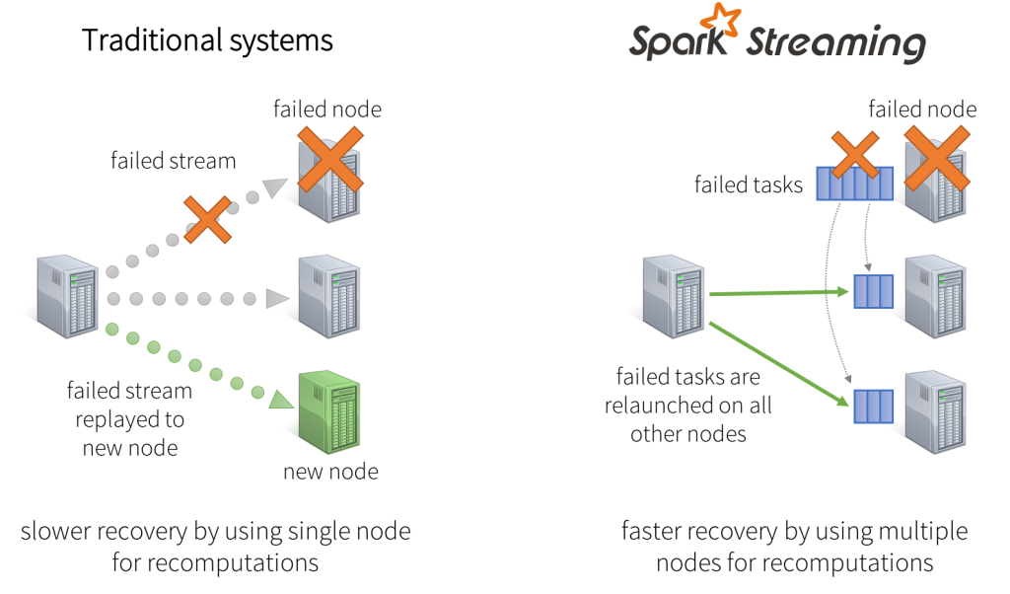
Spark Streaming Features
Fault Tolerance:
Spark has the ability to efficiently recover from failures.
Batches of input data are replicated in memory for fault-tolerance
Data lost due to worker failure, can be recomputed from replicated input data.
The system can recover from a failure in less than one second.
Notes:
Source: https://databricks.com/blog/2015/07/30/diving-into-apache-spark-streamings-execution-model.html

Slide 18
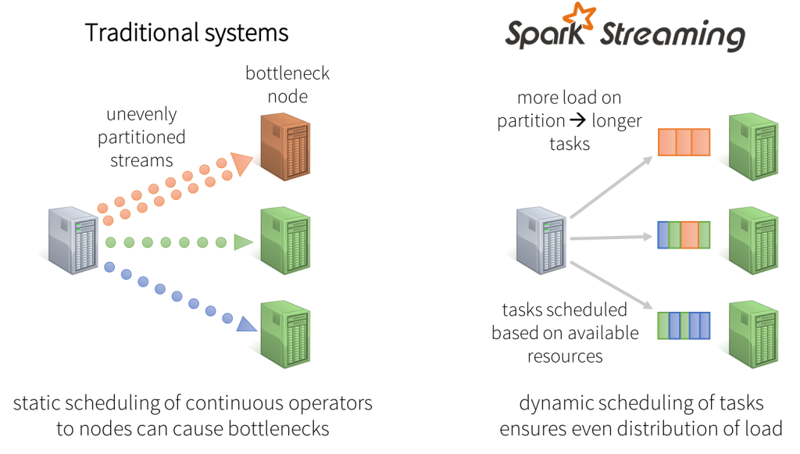
Spark Streaming Features (Cont’d)
Dynamic load balancing
Dividing the data into small micro-batches allows for fine-grained allocation of computations to resources.
In Spark Streaming, the job’s tasks will be naturally load balanced across the workers — some workers will process a few longer tasks, others will process more of the shorter tasks.
Notes:
Source: https://databricks.com/blog/2015/07/30/diving-into-apache-spark-streamings-execution-model.html

Slide 19
Learning Outlines
What is Streaming?
What is Spark Streaming?
Why Spark Streaming?
Spark Streaming Features
Discretized Stream
Spark Streaming Example

Slide 20
Discretized Stream
Discretized Stream (DStream) is the basic abstraction provided by Spark Streaming.
It represents a continuous stream of data, either:
the input data stream received from source, or
the processed data stream generated by transforming the input stream.
Internally, a DStream is represented by a continuous series of RDDs, and each RDD contains data from a certain interval.
Input DStream
Data From
Time 0 to 1
Data From
Time 1 to 2
Data From
Time 2 to 3
Data From
Time 3 to 4
RDD @ time 1
RDD @ time 2
RDD @ time 3
RDD @ time 4

Slide 21
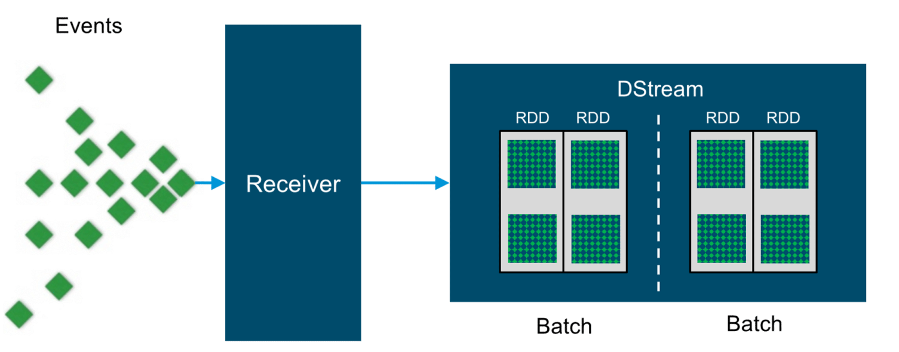
Input DStreams
Input DStreams:
Input DStreams are DStreams representing the stream of input data received from streaming sources.
Except for file stream, each input DStream is associated with a Receiver object.
This object stores the data received from a source in the memory of Spark for processing.
image: https://www.edureka.co/blog/spark-streaming
Notes:
https://spark.apache.org/docs/2.2.0/streaming-programming-guide.html#input-dstreams-and-receivers

Slide 22
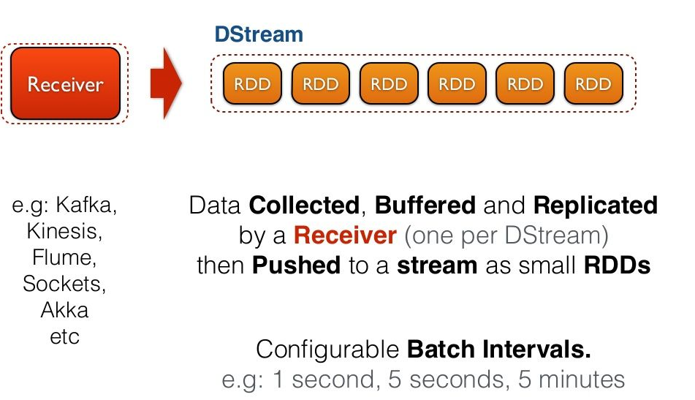
Input DStreams
Notes:
https://spark.apache.org/docs/2.2.0/streaming-programming-guide.html#input-dstreams-and-receivers
https://www.slideshare.net/frodriguezolivera/apache-spark-streaming

Slide 23
Input DStreams
Multiple Input DStreams:
If you want to receive multiple streams of data in parallel in your streaming application, you can create multiple input DStreams
This will create multiple receivers which will simultaneously receive multiple data streams. But note that a Spark worker/executor is a long-running task, hence it occupies one of the cores allocated to the Spark Streaming application.
Therefore, a Spark Streaming application needs to be allocated enough cores (or threads, if running locally) to process the received data, as well as to run the receiver(s).
Notes:
https://spark.apache.org/docs/2.2.0/streaming-programming-guide.html#input-dstreams-and-receivers

Slide 24
Input DStreams
There are two categories of built-in streaming sources:
Basic sources – These are the sources directly available in the StreamingContext API.
Examples: file systems, and socket connections.
Advanced sources – These sources require linking against extra dependencies.
Examples: Kafka, Flume, Kinesis, etc.
These sources available through extra utility classes.

Slide 25
DStream Receivers
There are two category of receivers base on their reliability:
Reliable Receiver
A reliable receiver is the one that correctly sends an acknowledgment to a source when the data receives and stores in Spark with replication.
Unreliable Receiver
An unreliable receiver does not send an acknowledgment to a source. This can use for sources when one does not want or need to go into the complexity of acknowledgment.

Slide 26
Transformations on DStreams
Similar to Spark RDDs, Spark transformations allow modification of the data from the input DStream.
DStreams support many transformations that are available on normal Spark RDD’s.

Slide 27
Transformations on DStreams
Some of the common ones are as follows.
Transformation | Explanation
map(func) | returns a new DStream by passing each element of the source DStream through a function func.
flatMap(func) | is similar to map(func) but each input item can be mapped to 0 or more output items and returns a new DStream by passing each source element through a function func.
filter(func) | returns a new DStream by selecting only the records of the source DStream on which func returns true.
reduce(func) | returns a new DStream of single-element RDDs by aggregating the elements in each RDD of the source DStream using a function func.
groupBy(func) | returns the new RDD which basically is made up with a key and corresponding list of items of that group.
Count() | Returns a new DStream of single-element RDDs by counting the number of elements in each RDD of source DStream

Slide 28
Output Operations on DStreams
Output operations allow DStream’s data to be pushed out to external systems like databases or file systems. Output operations trigger the actual execution of all the DStream transformations.
Transformation | Explanation
print() | prints first ten elements of every batch of data in a DStream on the driver node running the streaming application.
saveAsTextFiles( prefix, [suffix]) | Saves DStream’s contents as text files; the file name at each batch interval is generated based on prefix and suffix: “prefix[.suffix]”.
saveAsObjectFiles(prefix, [suffix]) | Saves DStream’s contents as a SequenceFile of serialized Java objects; the file name at each batch interval is generated based on prefix and suffix: “prefix[.suffix]”
saveAsHadoopFiles(prefix, [suffix]) | Saves DStream’s contents as a Hadoop file; the file name at each batch interval is generated based on prefix and suffix: “prefix[.suffix]”
foreach(func) | Applies a function, func, to each RDD generated from the stream; this function should push the data in each RDD to an external system, like saving the RDD to files, or writing it over the network to a database.

Slide 29
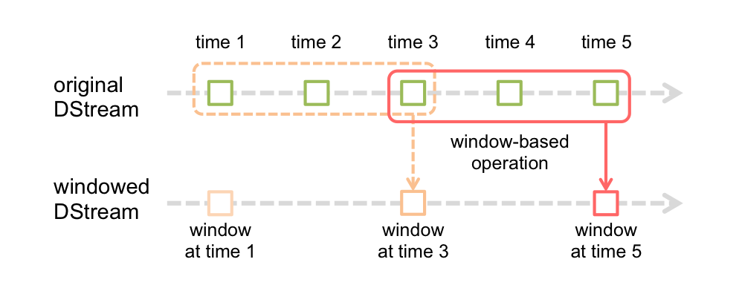
Window Operations on DStreams
Spark Streaming also supports window operations that helps to implement transformations over a window of data that is sliding.
As depicted, each time a window is sliding over a DStream source, the RDDs source falling within that particular window are being united. They are then being operated upon for producing the windowed DStream RDDs.
image source: https://spark.apache.org/docs/latest/streaming-programming-guide.html

Slide 30
Window Operations on DStreams
Basically, any Spark window operation requires specifying two parameters.
Window length – It defines the duration of the window (3 in the figure).
Sliding interval – It defines the interval at which the window operation is performed (2 in the figure).
Hence, In the last specific case, the operation is applied over the last 3 time units of data, also slides by 2-time units.

Slide 31
Window Operations on DStreams
Transformation | Explanation
Window(windowLength, slideInterval) | Returns a new DStream, which is computed based on windowed batches of the source
countByWindow( windowLength, slideInterval) | Returns a sliding window count of elements in the stream
reduceByWindow (func, windowLength, slideInterval) | Returns a new single-element stream, created by aggregating elements in the stream over a sliding interval using func, which should be associative so that it can be computed correctly in parallel.
reducedByKeyAndWindow (func, windowLength, slideInterval) | when called on a DStream of (K, V) pairs, returns a new DStream of (K, V) pairs where the values for each key are aggregated using the given reduce function func over batches in a sliding window.
The window length is defined as the window duration, whereas the sliding interval is defined as the window operation interval at which it is being executed.

Slide 32
Window Operations on DStreams (examples)
In the next examples, we will use the following windowLength and slideInterval values:
windowLength = 30
slideInterval = 10
# a new DStream which is computed based on windowed batches of stream1
windowedStream1 = stream1.window(30, 10)
# count of elements in the stream1 count_windowed = stream1.countByWindow(30,10)

Slide 33
Window Operations on DStreams (example)
# adding elements in ‘number’ stream (Let’s assume that number is stream of integer values
windowedNumberSum
= number.reduceByWindow(lambda x, y: x + y, 30, 10)

Slide 34
Window Operations on DStreams (example)
Word counts example by using the last 30 seconds of data, in every 10 seconds.
To do this, we have to apply the reduceByKey operation on the pairs DStream of (word, 1) pairs over the last 30 seconds of data.
This is done using the operation reduceByKeyAndWindow.
windowedWordCounts =
pairs.reduceByKeyAndWindow(lambda x, y: x + y, lambda x, y: x - y, 30, 10)
“reduce” the new values that entered the window (e.g., adding new counts)
"inverse reduce" the old values that left the window (e.g., subtracting old counts)

Slide 35
MLlib Operations
MLlib machine learning algorithms can be easily used in the Spark Context.
There are streaming machine learning algorithms which can simultaneously learn from the streaming data as well as apply the model on the streaming data. For example:
Streaming linear regression
Streaming k-means
For other machine learning algorithms, you can learn a learning model offline (i.e. using historical data), then load the model and use it online on streaming data.

Slide 36
Learning Outlines
What is Streaming?
What is Spark Streaming?
Why Spark Streaming?
Spark Streaming Features
Discretized Stream
Spark Streaming Example

Slide 37
Spark Streaming Example
In this example, we want to count the number of words in text data received from a Kafka producer.
First, we import “StreamingContext”, which is the main entry point for all streaming functionality.
We create a local StreamingContext with two execution threads, and batch interval of 1 second.

Slide 38
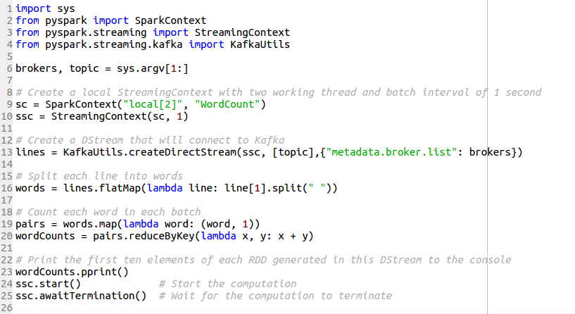
Spark Streaming Example (Cont’d)

Slide 39
Spark Streaming Example (Cont’d)
You can start Zookeeper server:
Zookeeper-path$ bin/zookeeper-server-start.sh config/zookeeper.properties
Then, in a different terminal, you can start Kafka:
Kafka-path$ bin/kafka-server-start.sh config/server.properties
Let's create a topic named "topic1" with a single partition and only one replica:
Kafka-path$ bin/kafka-topics.sh --create --zookeeper localhost:2181 --replication-factor 1 --partitions 1 --topic topic1
This is the name of topic that we will use it in the Apache Spark.

Slide 40
Spark Streaming Example (Cont’d)
Run the producer and then type a few messages into the console to send to the server.
Kafka-path$ bin/kafka-console-producer.sh --broker-list localhost:9092 --topic topic1
hello world hello Spark hello world ...

Slide 41
Spark Streaming Example (Cont’d)
To run this example, we need to use the following command in a terminal:
Spark-path$ bin/spark-submit --packages org.apache.spark:spark-streaming-kafka-0-8_2.11:2.0.1 /path/to/code/streamwordCount.py localhost:9092 topic1
This is the name of topic that we create in the Apache Kafka.

Slide 42
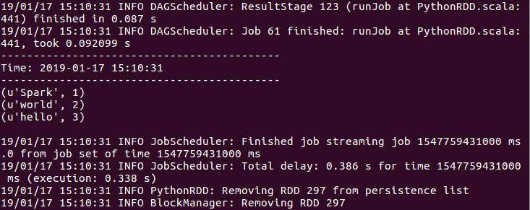
Spark Streaming Example (Cont’d)
The result will be shown in the running Spark terminal:

Slide 43
Summary
Spark Streaming is the core Spark API’s extension that allows high-throughput, scalable, and fault-tolerant stream processing of data streams that are live.
DStream is a high-level abstraction and represents a continuous stream of data and represented as an RDD sequence internally.
Micro batching is a core Spark technique that lets a task or process handle a stream as a sequence containing data chunks or small batches.
Input DStreams represent the input data stream that is received from sources of streaming.
There are two topologies or categories of built-in streaming sources provided by Spark Streaming: basic sources and advanced sources.
Transformations let the data from the input DStream be altered.
Output operations let the data of DStreams be pushed to external systems such as file system or a database.

Slide 44
References
Spark Streaming Guide:
https://spark.apache.org/
https://docs.databricks.com/spark/
https://www.simplilearn.com/spark-streaming-tutorial-video

